Slide 1

Global Insights: Visualizing Sales and Profit Trends in E-Commerce
Team members:
Nikhil Kattaguri
Sathvika Shetti

Slide 2

Introduction
Our team will analyze the Global Superstore Dataset to determine patterns of sales, profit, and customer trends by product category and region. The dataset we have chosen consists of 51,290 rows and 24 columns. The dataset includes sales, profit, and customer data for a global superstore, covering multiple regions, product categories, and order details.

Slide 3
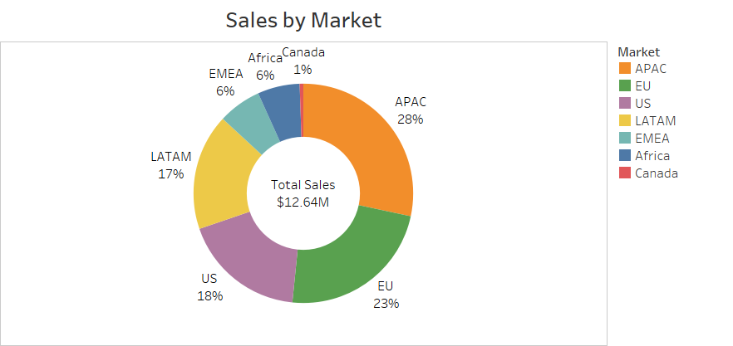
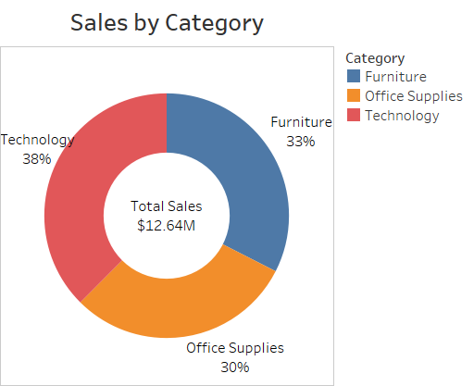
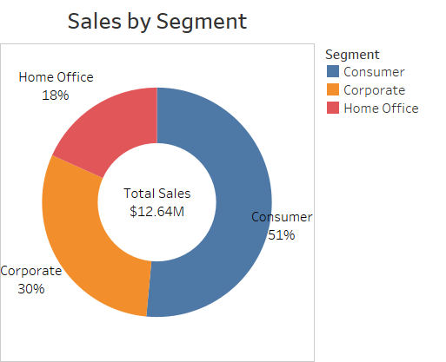
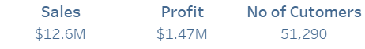
In this analysis, the sales distribution based on different markets by Category and Segment.
For example:
APAC led regional sales (28%), while Technology was the top category (38%). Consumer sales dominated segments (51%), driving total revenue to $12.64M.

Slide 4
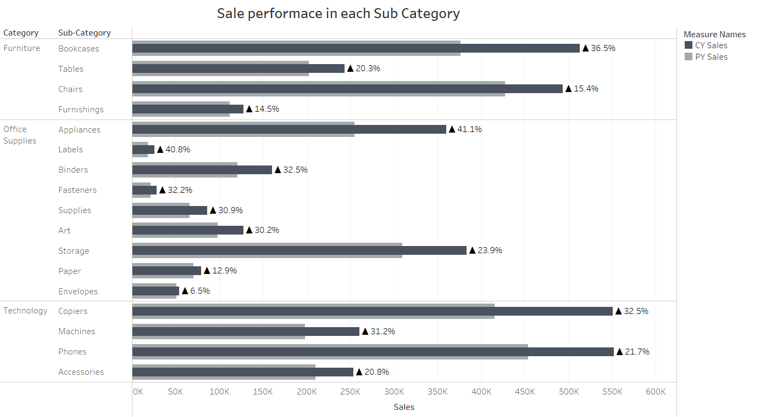
The chart compares sales performance across sub-categories in 2014, showing both current year (CY) and previous year (PY) sales. Most sub-categories experienced significant sales growth, with Appliances, Labels, and Bookcases showing the highest percentage increases.

Slide 5
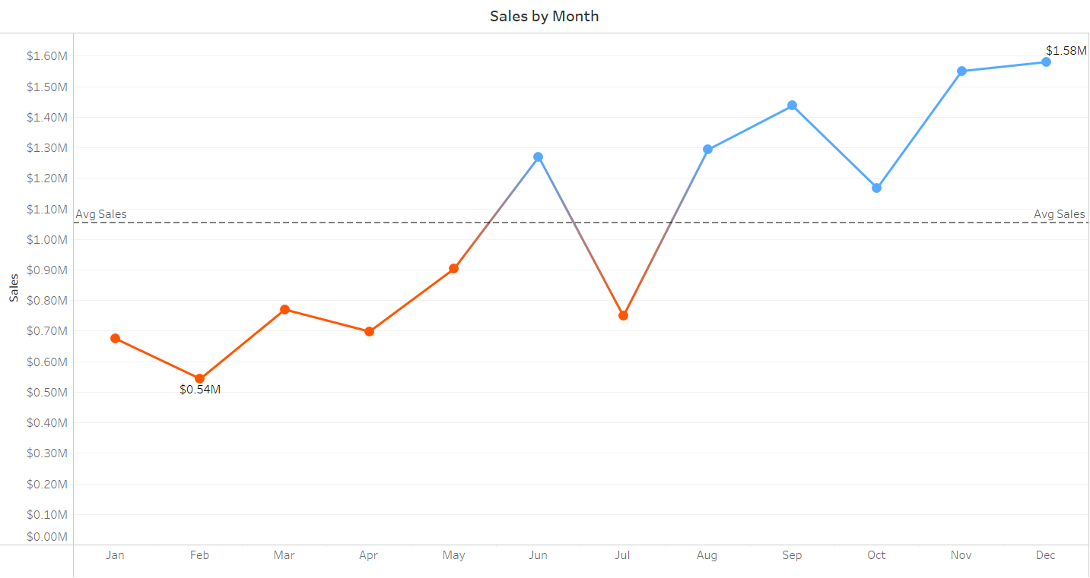
This line chart shows monthly sales trends over the year. It highlights a steady increase in sales after mid-year, with sales consistently exceeding the average sales mark in the second half.

Slide 6
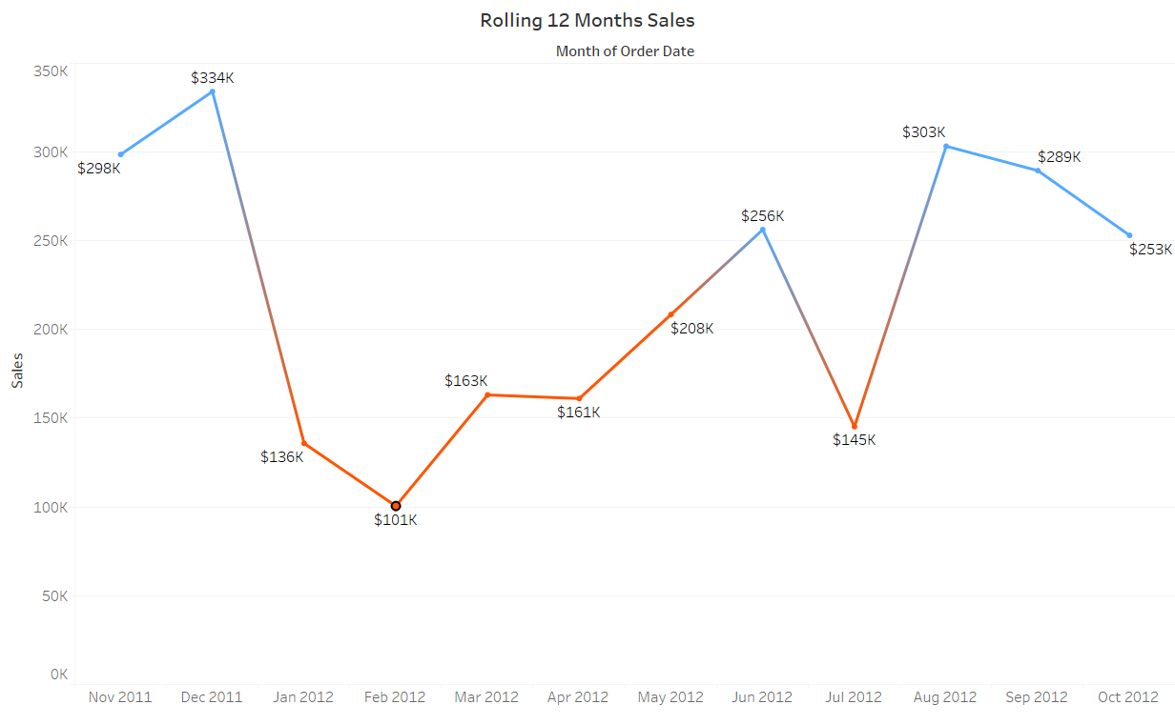
The rolling 12-month sales chart captures the growth in sales performance over a year. It demonstrates seasonal variations, with notable peaks and dips, but an overall upward trend.

Slide 7
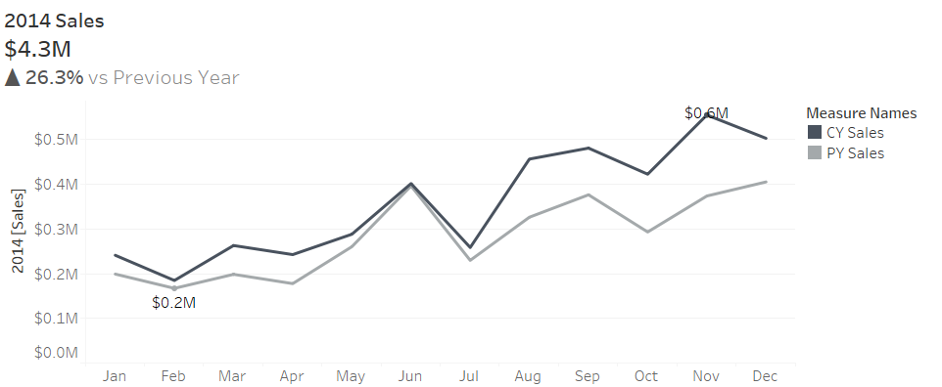
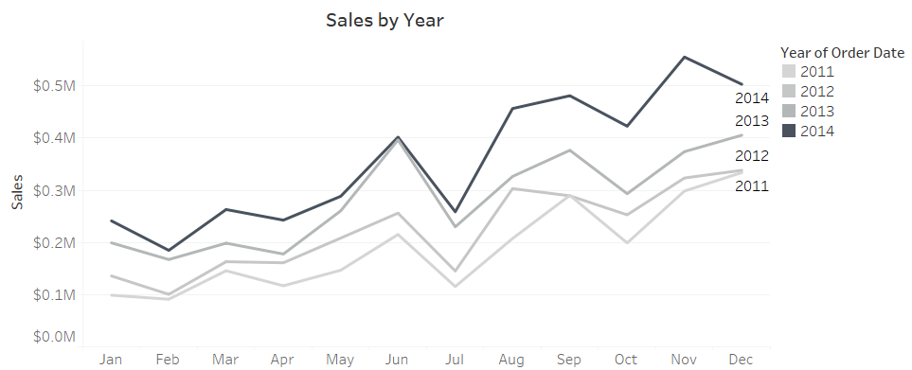
Sales in 2014 reached $4.3M, growing 26.3% over the previous year, with the strongest performance in November at $0.6M
Year-over-year trends show consistent growth from 2011 to 2014, with each year outperforming the last, especially in the second half

Slide 8
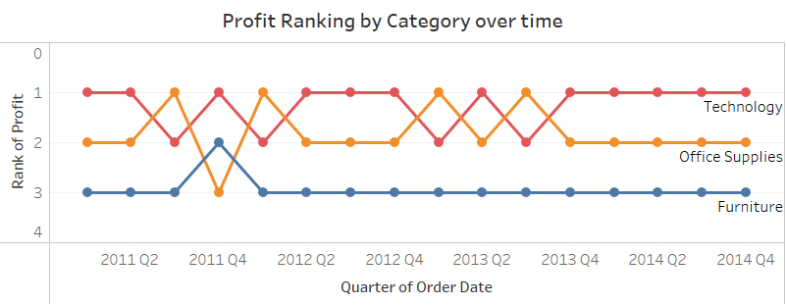
This bump chart contrasts Technology, Furniture, and Office Supplies sales. Technology tops the chart, followed by Office Supplies, which typically takes the third place.

Slide 9
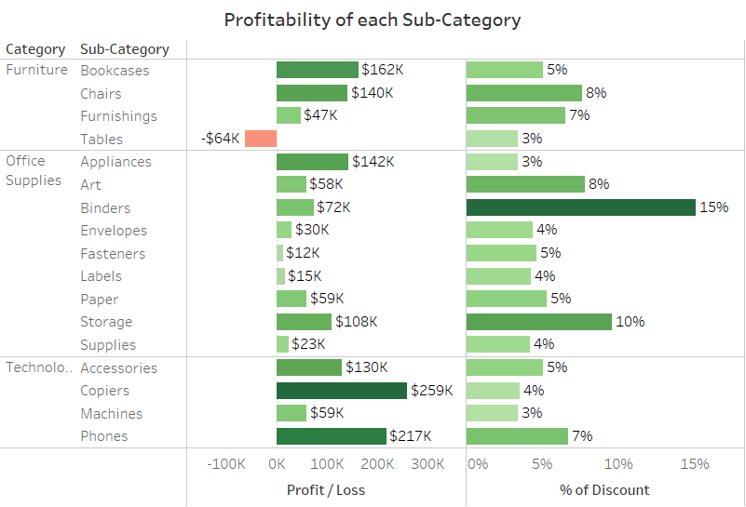
Phones, Chairs, and Bookcases lead in sales, while Copiers and Phones generate the most profit. Tables stand out with the biggest loss of -$64K. Binders offer the highest discount at 15%. Focus on reducing discounts and addressing losses in low-performing categories.

Slide 10
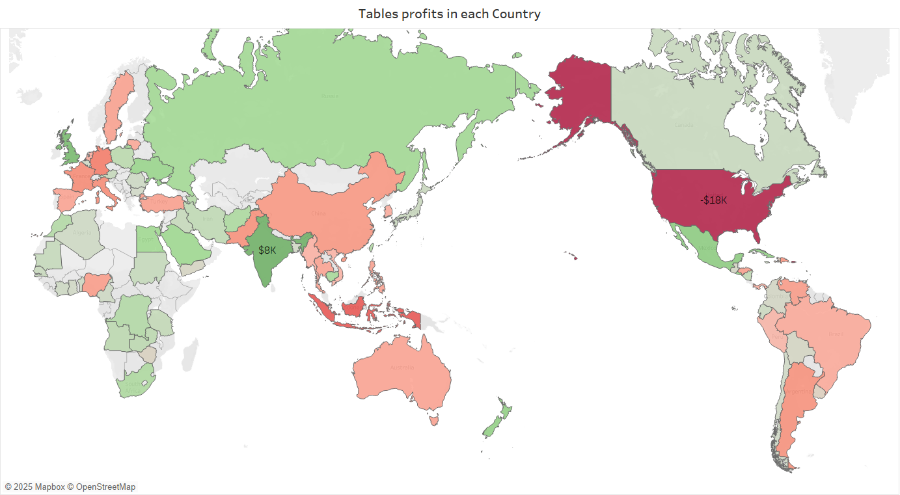
USA is the Country with the highest loss in the “Tables” subcategory of 18,000 dollars.

Slide 11
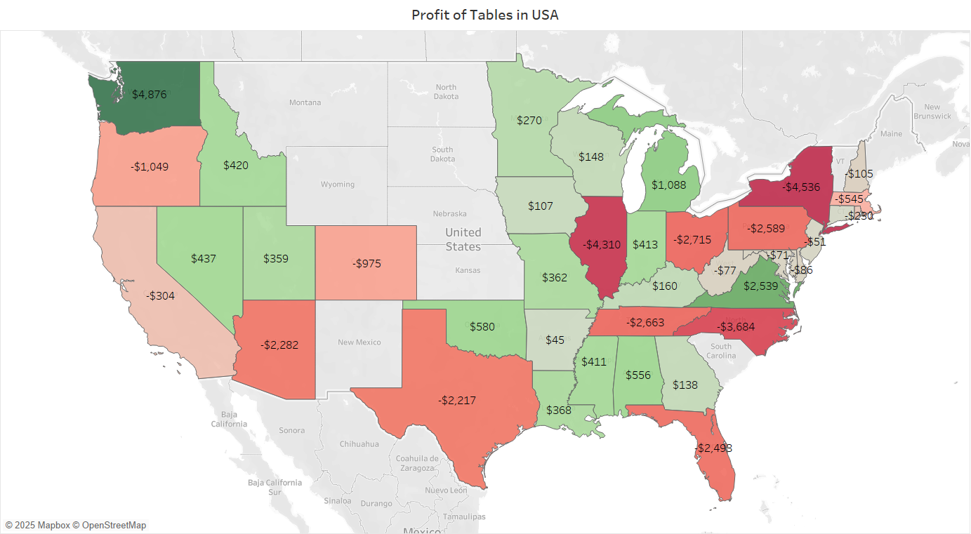
This map shows the profit of tables across different U.S. states. We can clearly see that many states, like Illinois, North Carolina, and New York, have large losses (highlighted in red) and profits in the negative thousands. On the other hand, a few states like California, Michigan, and Florida show positive gains, though these are fewer. Eliminating tables from the states having large losses like Illinois, North Carolina, and New York may reduce losses and put in profits.

Slide 12
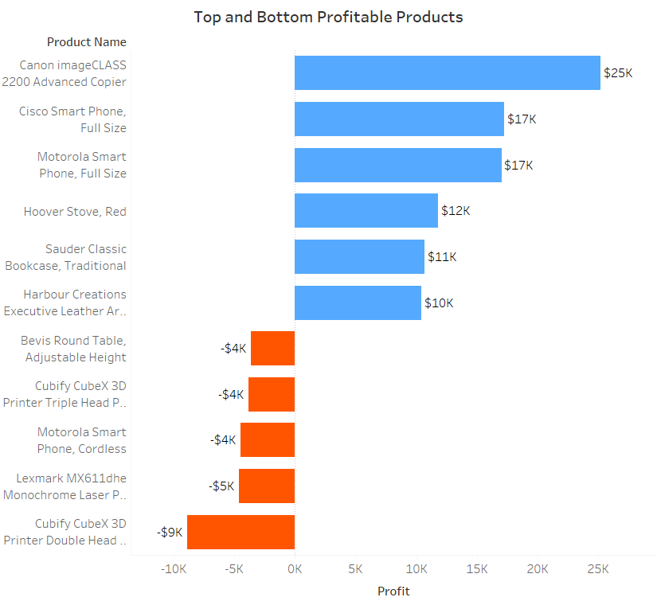
The most profitable products are the Canon Copier and Cisco and Motorola Phones. The least profitable are mainly 3D Printers and the Lexmark Printer. Shifting efforts toward top-performing products and reconsidering or discontinuing weak ones could improve overall margins.

Slide 13
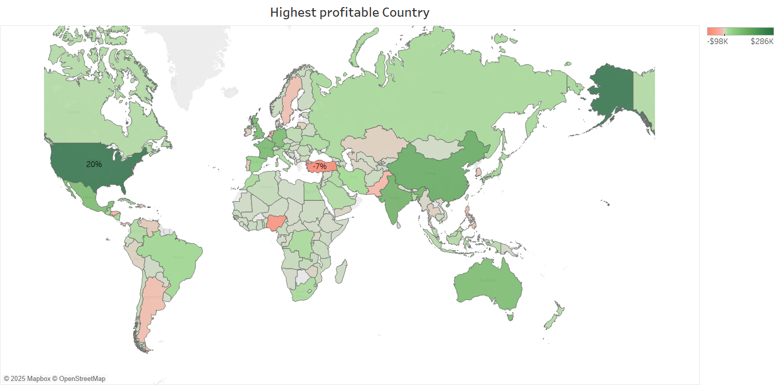
The profitability map highlights key markets based on their performance.
The United States leads significantly, contributing 20% to total profits, marked by the deepest green on the map.
Other countries show varied results, with some regions reflecting lower profitability.

Slide 14
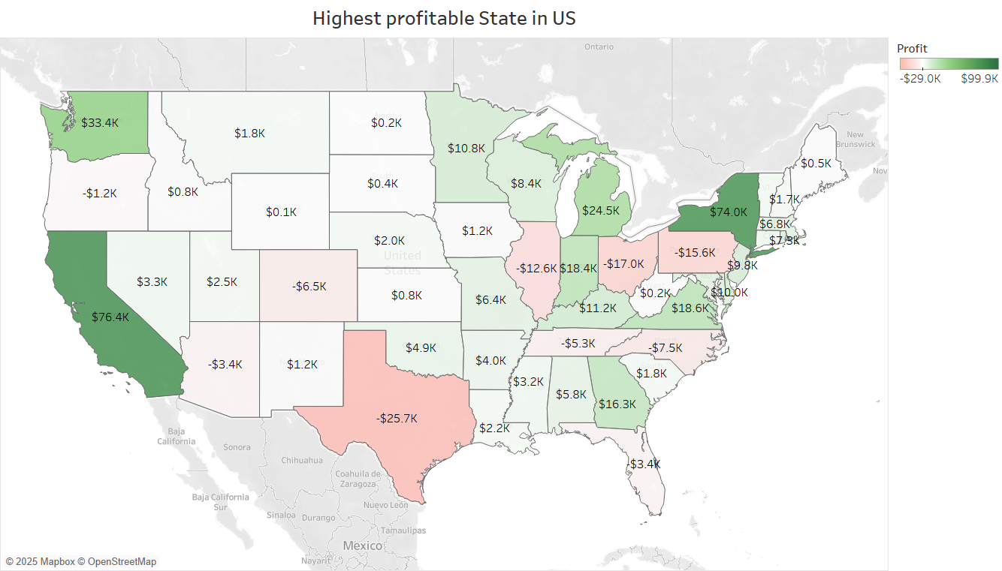
In this analysis, we identify the profit distribution across different states in the United States.
For example:
California has the highest profit, with a value of $76.4K.
New York follows closely with $74.0K profit.
Meanwhile, Texas shows the largest loss, with -$25.7K.

Slide 15
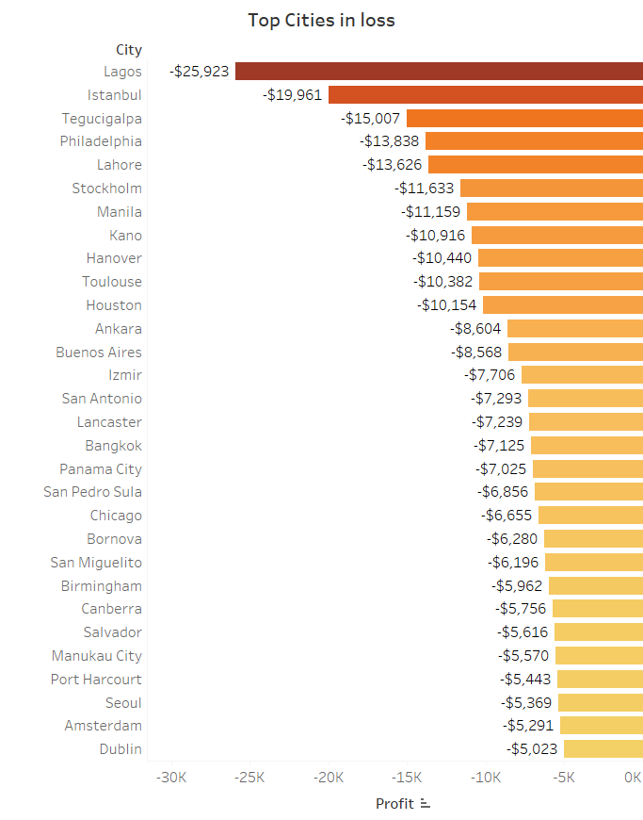
Lagos and Istanbul experienced the highest losses, with profits of -$25,923 and -$19,961 respectively. The chart highlights that several cities worldwide faced significant negative profits, with all listed cities incurring losses above $5,000.

Slide 16
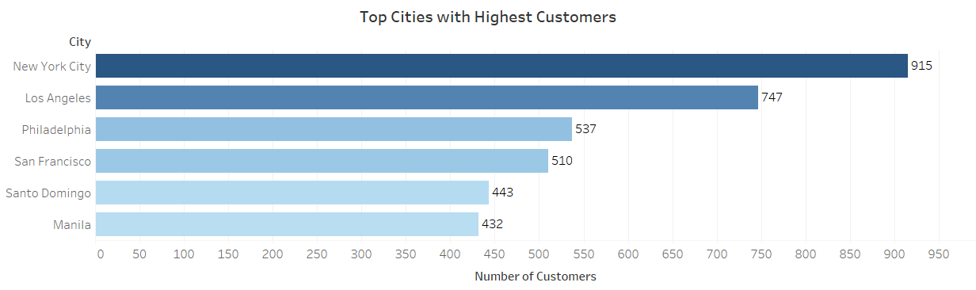
New York City and Los Angeles have the highest number of customers, with 915 and 747 respectively

Slide 17
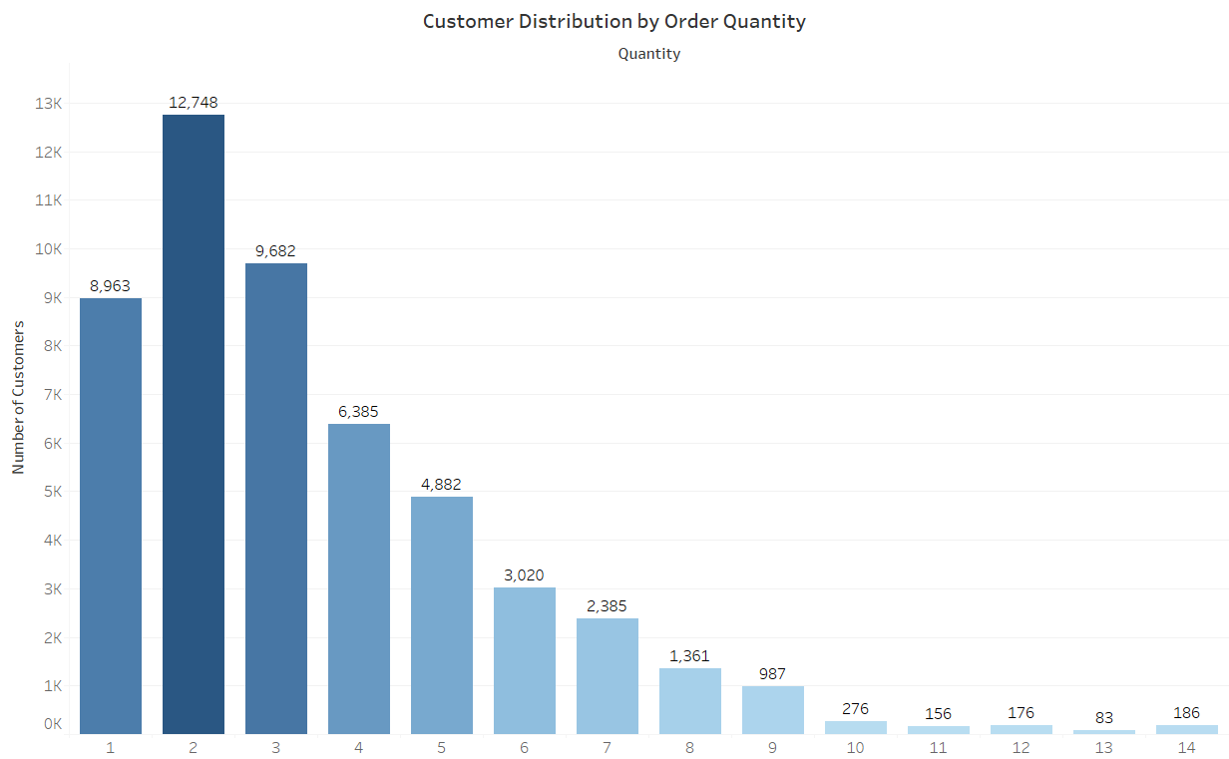
Most customers place small orders, as the majority order just 1 or 2 items, with order frequency sharply decreasing for higher quantities.

Slide 18
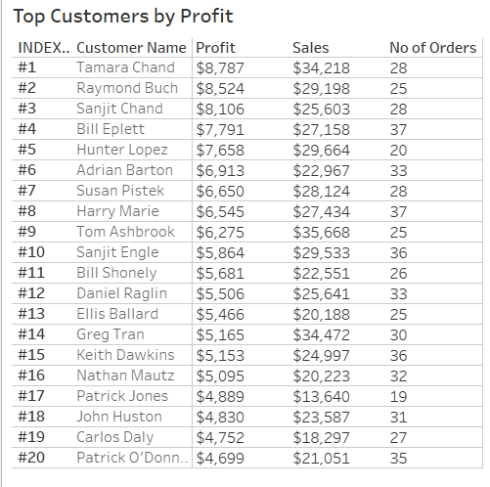
Top customers like Tamara Chand and Raymond Buch consistently bring in high profits with 28 and 25 orders each. Building stronger relationships with these loyal, high-value customers could further boost revenue and retention.

Slide 19

Conclusion
In conclusion, our analysis of the Global Superstore Dataset revealed valuable insights into sales and profit trends across different categories and regions. Understanding these patterns can help businesses make informed decisions to drive growth. Thank you.

